Slide 1
Quantum Algorithms & Encryption

Slide 2
Learning Outcomes
By the end of this lesson, students will be able to:
Explain the principles of key quantum algorithms (Shor’s, Grover’s) and how they exploit superposition and entanglement for speedups.
Describe the computational advantages and limitations of quantum algorithms vs classical counterparts.
Illustrate how Shor’s algorithm breaks RSA and ECC through period-finding using quantum Fourier transform.
Demonstrate how Grover’s algorithm accelerates brute-force attacks and weakens symmetric cryptosystems like AES-128.
Compare symmetric, asymmetric, and post-quantum hybrid encryption methods, including performance trade-offs (speed, key size, ciphertext size).
Evaluate the role of hybrid encryption (e.g., Kyber + AES) in securing communication in the post-quantum era.

Slide 3
What Is A Quantum Algorithm?
Definition: A quantum algorithm is a step-by-step computational procedure designed to run on a quantum computer by manipulating qubits using principles like superposition, entanglement, and interference to solve problems more efficiently than classical algorithms.
Key Characteristics:
Superposition: Allows a quantum algorithm to explore many possibilities at once.
Entanglement: Links qubits so that their outcomes are correlated, enabling powerful computations.
Interference: Enhance correct solutions while cancelling out wrong ones via amplitude manipulation.

Slide 4
Quantum VS Classical Algorithms
Classical algorithms operate step-by-step, checking one solution at a time.
Quantum algorithms use superposition to explore many possibilities simultaneously.
This parallelism allows for exponential or quadratic speedups over classical methods for certain problems.

Slide 5

Key Quantum Algorithms

Slide 6
Shor’s Algorithm
Shor’s Algorithm is a quantum algorithm that can break RSA encryption by factoring large numbers very quickly — something classical computers struggle to do.
What Problem Does It Solve?
RSA encryption relies on the fact that it’s very hard to find the two prime numbers that multiply to form a large number (e.g., 2048-bit). On a classical computer, factoring takes years or centuries. But with Shor’s algorithm, a quantum computer could do it in hours or minutes.
With this, RSA and ECC encryption become breakable in a post-quantum world.

Slide 7
How It Works
Phase 1: Classical Reduction
Goal: Turn the factoring problem into a period-finding problem.
Steps:
Choose a random number x, such that 1 < x < N, where N is the number you want to factor.
Check if x shares a factor with N:
Use the Greatest Common Divisor (GCD) method.
If GCD(x, N) ≠ 1, you’ve already found a factor!
If GCD(x, N) = 1, then move on - x and N are coprime.
Define a function:
f(a) = x^a mod N
This function repeats in cycles - meaning it has a period r, where:
x^r mod N = 1
Your goal: Find the period r - once you know it, you can calculate factors of N using: GCD(x^(r/2) ± 1, N)

Slide 8
How It Works
Phase 2: Quantum Period Finding
Goal: Use a quantum computer to find the period r efficiently.
1. Initialize Qubits
2. Apply Modular Function f(a) = xª mod N
3. Measure Output Register
Prepare the first register in superposition: |0⟩ → (|0⟩ + |1⟩ + ... + |q−1⟩)
Second register is initialized as |0⟩
Collapses output to a fixed value: |f(s)⟩
Leaves only inputs that share that output: |s⟩, |s+r⟩, |s+2r⟩, etc.
Compute f(a) for all a in parallel (quantum entanglement)
State becomes: Σ |a⟩|f(a)⟩
4. Apply Quantum Fourier Transform (QFT)
5. Measure Input Register
6. Use Classical Post-processing
Reveals periodicity in the input register Converts the pattern into measurable peaks
Observe a value = multiple of q/r
Use Continued Fractions to approximate r from measurement
Run GCD checks: GCD(x^r/2 ± 1, N) to find the factors

Slide 9
Advantages & Limitations
Quantum Advantage:
Shor’s runs in polynomial time (O(log N)²), compared to the best classical algorithms that take sub-exponential time.
This quantum speedup makes RSA insecure once large-scale quantum computers are available.
Limitations Today:
Current quantum hardware can only factor small numbers (like 15 or 21).
Demonstrations often rely on shortcuts or classical help, not true scalable quantum execution.

Slide 10
Grover’s Algorithm
Purpose:
Speed up brute-force search from O(N) to O(√N) using quantum computing.
Eg. Searching for your friend’s phone number in a random list of N names.
Classical search time: ~N/2 steps
Quantum (Grover’s) search time: ~√N steps

Slide 11
How It Works
Steps:
Initialize L qubits to state
|0⟩ = |00 … 0⟩
Apply Hadamard transformation to generate a superposition of all possible states
Repeat √N times:
Apply the Oracle Uₘ to mark the correct state
Apply Diffusion Operator (inverts all amplitudes around the average)
Measure the quantum register → High chance of getting the target state
Key Idea: The amplitude of the correct answer is amplified at each step.

Slide 12
Use Cases
Not useful for searching conventional databases (requires quantum data input)
Very useful for brute-force cryptanalysis:
Symmetric key systems like AES-128
→ Grover reduces effective key strength from 128-bit to 64-bit
Quantum computers could break classical encryption much faster
Grover’s algorithm weakens symmetric encryption—but can be mitigated by doubling key size (e.g., use AES-256).

Slide 13
Real-World Applications

Slide 14
Shor’s Algorithm
Quantum Supremacy (Google, 2019)
Quantum Communication (China, 2016-Present)
Democratizing Access (IBM Quantum Experience)
Breakthrough: Sycamore processor solved a task in 200 seconds vs 10,000 years for classical supercomputers.
Significance: First proof that quantum computers can outperform classical ones for specific problems
Micius Satellite: Enabled quantum-secure communication over 1,200 km via QKD
Impact: Foundation for hack-proof global networks
Cloud Platform: Allows researchers to run experiment on real quantum hardware
Community Growth: 500+ academic institutions and companies collaborating

Slide 15
Grover’s Algorithm
Cryptanalysis
Hash Collisions
Quantum Machine Learning
Grover's algorithm weakens symmetric encryption like AES-128, reducing brute-force security from 2¹²⁸ to 2⁶⁴ operations. This forces adoption of AES-256 for quantum resistance.
It accelerates pre-image attacks on hashes (e.g., SHA-256 → 2¹²⁸ ops vs. 2²⁵⁶ classically), pushing migration to quantum-resistant SHA-3-512 for security-critical systems.
Grover's enables faster quantum K-nearest neighbors (QKNN), offering quadratic speedups for tasks like drug discovery by optimizing high-dimensional pattern matching.

Slide 16
Encryption Methods

Slide 17
Types of Encryption
Classical
Post-Quantum
Symmetric (eg. AES-256): Same key for encryption/decryption; fast; used for bulk data.
Asymmetric (eg. RSA-2048): Public/private key pair; slower; used in key exchange, digital signatures.
PQ Hybrid (eg. Kyber + AES): Combines a quantum-safe key exchange (Kyber) with AES; balances speed and future-proofing.

Slide 18
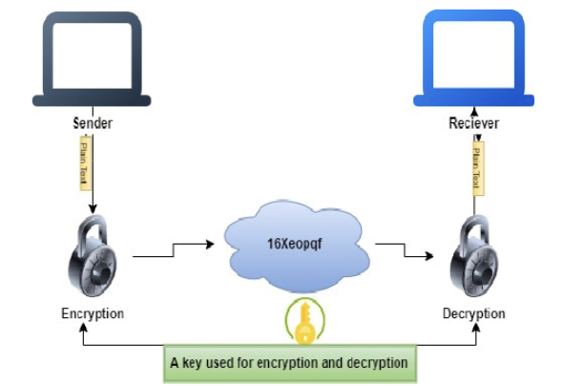
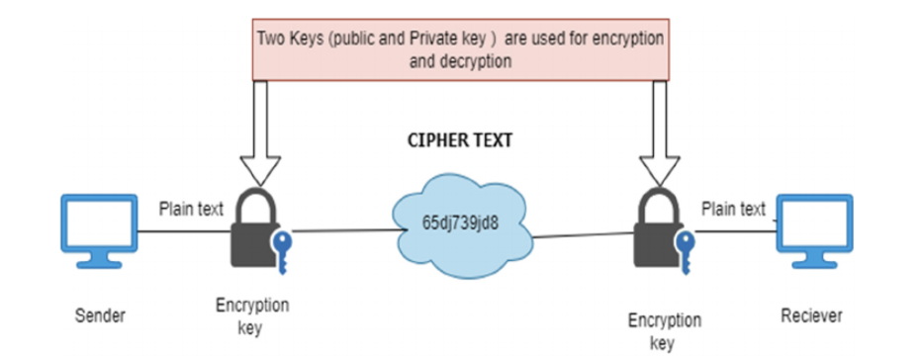
Classical
Symmetric
Asymmetric

Slide 19
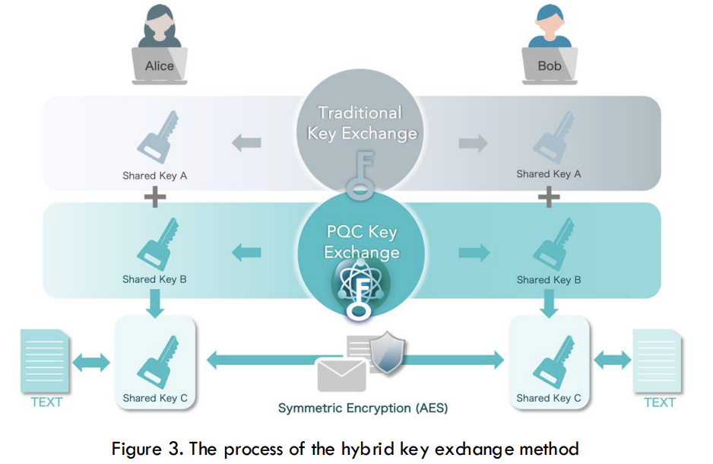
Post-Quantum Hybrid
1. Traditional Key Exchange: Initially, Alice and Bob attempt to establish a shared key (Shared Key A) using a traditional algorithm vulnerable to quantum attacks.
2. PQC Key Exchange: Concurrently, Alice and Bob engage in a PQC key exchange, leveraging their respective PQC key pairs to generate a secure Shared Key B, resistant to quantum attacks.
3. Decryption and Final Key Generation: Bob, possessing the corresponding PQC private key, decrypts the received package to obtain Shared Key A. Both parties now utilize Shared Key A to derive a final symmetric key, Shared Key C.
4. Secure Message Exchange: With Shared Key C in place, Alice encrypts the message ("TEXT") and sends it to Bob, who can then decrypt and read the message securely.

Slide 20
Key Size
Larger keys provide exponentially stronger encryption:
AES-256: Takes ~2²⁵⁶ attempts to brute-force.
RSA-2048: Secure against classical attacks, but vulnerable to Shor’s algorithm.
Kyber: NIST-approved for post-quantum security.
Why It Matters:
Bigger keys = stronger protection, especially against future quantum threats
Key size directly impacts resistance to brute-force and quantum attacks
Critical for defense, government, and long-term data protection

Slide 21
Ciphertext Size
Different algorithms produce different ciphertext sizes:
AES-256: Small output (~64 bytes)
RSA-2048: Moderate size (~256 bytes)
Kyber + AES: Larger output (~1KB+)
Why It Matters:
Larger ciphertext = more data to transmit, store, and process
Affects speed and efficiency in real-time systems and low-bandwidth environments (e.g., IoT, mobile)
Represents a trade-off: higher security often comes with lower efficiency
Important for secure messaging, military communication, and critical infrastructure

Slide 22
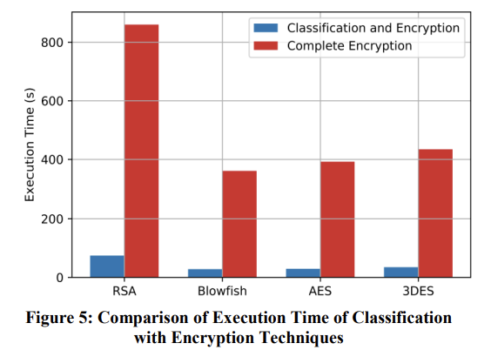
Speed VS Security
AES-256: Fast encryption/decryption
RSA-2048: Slower
Kyber + AES: Balanced hybrid
Trade-offs:
Faster = better for real-time
Slower = more secure (sometimes)
Hybrid = best of both, but more resource intensive
The figure shows that RSA takes longer time than AES

Slide 23
Lab Activity - Comparing AES, RSA & Kyber
Purpose: Benchmark the 3 encryption methods and analyze trade-offs
What to Use:
A python program
Worksheet with instructions and questions to record down your findings.
Analyze:
Which method is fastest?
How does key size affect performance?
Why does ciphertext size matter?

Slide 24
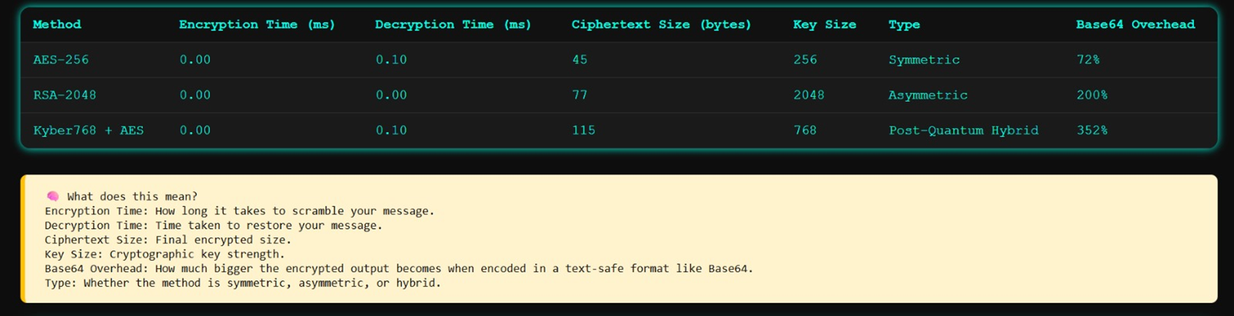
Sample Output

Slide 25
Conclusion
Quantum computing represents both a revolution and a threat to modern cryptography. Shor’s and Grover’s algorithms demonstrate how quantum mechanics can break classical encryption (RSA, ECC, AES-128) while enabling new computational paradigms (quantum ML, secure communications).
Key Takeaways
Urgent transition needed:
Shor’s algorithm will break RSA/ECC—PQC standards (Kyber, Dilithium) must replace them.
Grover’s algorithm weakens symmetric encryption—AES-256 and SHA-3-512 are now mandatory.
Hybrid solutions are critical:
Combine quantum-safe key exchange (Kyber) with classical encryption (AES) for balance.

Slide 26
Kahoot Quiz
https://create.kahoot.it/share/updated-qc-algorithms/1f59e879-bc0a-4c23-9e21-15ee66fe5a52

Slide 27
References
de Wolf, R. (n.d.). Quantum computing: Lecture notes. InfoBooks. Retrieved from https://www.infobooks.org/pdfview/13963-quantum-computing-lecture-notes-ronald-de-wolf/
cnlab Security AG. (2025). Post-Quantum Cryptography – A Comprehensive Guide. Retrieved from https://www.cnlab.ch/fileadmin/documents/Publikationen/2025/Post-Quantum_Cryptography_-__A_Comprehensive_Guide.pdf
Neupane, M. (2024). Shor’s Algorithm – Seminar Report. ResearchGate. Retrieved from https://www.researchgate.net/publication/382830108_Shor%27s_Algorithm_Seminar_Report_Mahendra_Neupane
White, D. (n.d.). Quantum Cryptography – CS584 Final Project. Purdue University. Retrieved from https://www.cs.purdue.edu/homes/white570/media/CS_584_Final_Project.pdf
Arute, F., Arya, K., Babbush, R., et al. (2019). Quantum supremacy using a programmable superconducting processor. Nature, 574(7779), 505–510. https://doi.org/10.1038/s41586-019-1666-5
National Institute of Standards and Technology (NIST). (n.d.). Post-Quantum Cryptography Standardization. Retrieved from https://csrc.nist.gov/projects/post-quantum-cryptography/post-quantum-cryptography-standardization
National Institute of Standards and Technology (NIST). (n.d.). What is Post-Quantum Cryptography? Retrieved from https://www.nist.gov/cybersecurity/what-post-quantum-cryptography
Cloudflare. (2022). From Post-Quantum to Origins: Transitioning Securely. Retrieved from https://blog.cloudflare.com/post-quantum-to-origins/

Slide 28
References
Banque de France & Monetary Authority of Singapore. (2024). Groundbreaking Post-Quantum Cryptography Experiment in Financial Systems. Retrieved from https://www.banque-france.fr/en/press-release/banque-de-france-and-monetary-authority-singapore-conduct-groundbreaking-post-quantum-cryptography
U.S. National Security Agency (NSA). (2023). Post-Quantum Cryptography: CISA, NIST, and NSA Recommend How to Prepare Now. Retrieved from https://www.nsa.gov/Press-Room/Press-Releases-Statements/Press-Release-View/article/3498776/post-quantum-cryptography-cisa-nist-and-nsa-recommend-how-to-prepare-now
/National Cyber Security Centre (UK). (2023). Post-Quantum Cryptography Migration Timelines. Retrieved from https://www.ncsc.gov.uk/guidance/pqc-migration-timelines

